Slide 1
ANALYZING FEDERAL PROCUREMENT DATA
AMBER GERSHMAN, HELINA SOLOMON, MOHAMMAD RAZA, JOEL BATTLE, CARA WILLIAMS
AUGUST, 2020
GROUP 1

Slide 2
Project 1 –
In this project we will cover:
Top 100 contractors report for the 2019 fiscal year
Analysis of funding by agency and vendors
Analysis of funding by states
Funding by congressional districts
Funding by party affiliation
Observations based on the data

Slide 3
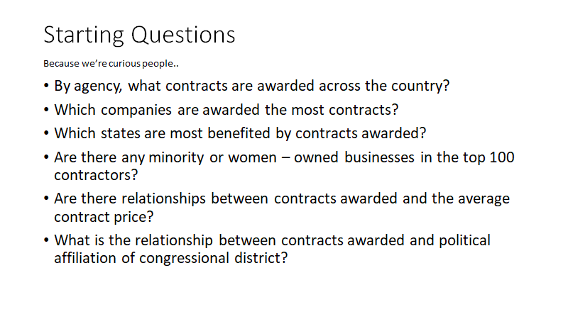

Slide 4
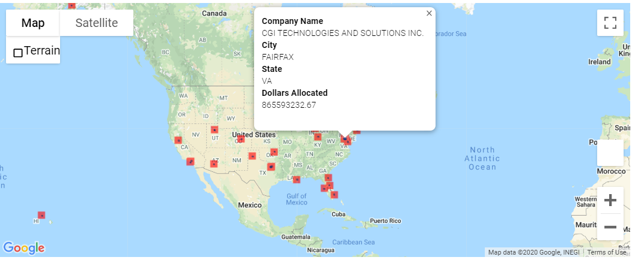

Slide 5
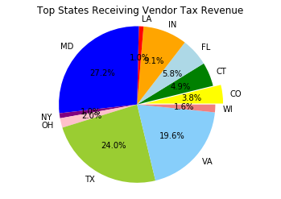

Slide 6
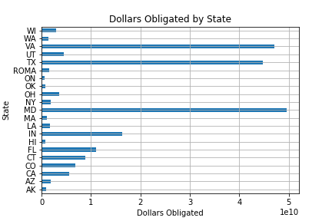

Slide 7
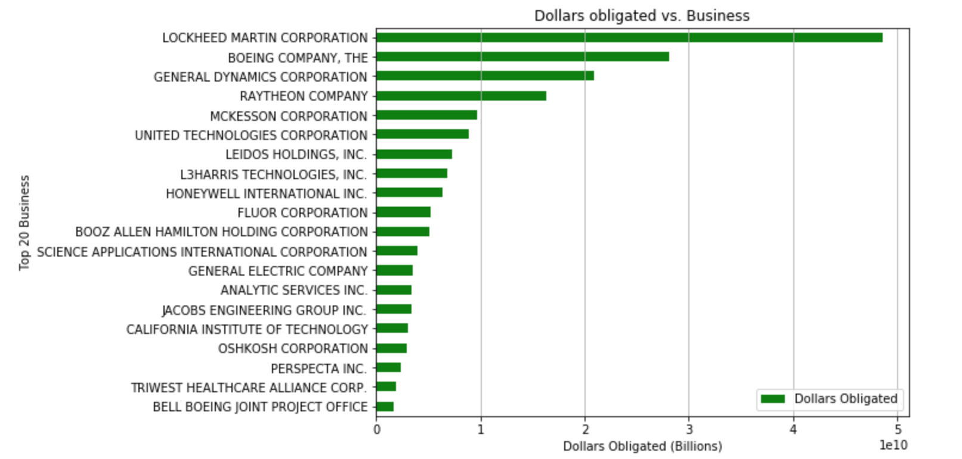

Slide 8
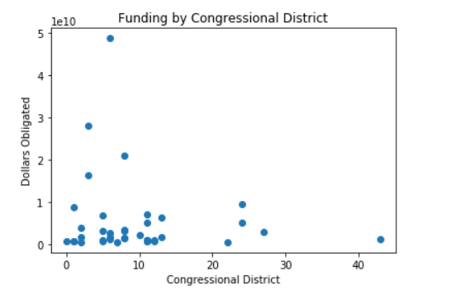

Slide 9
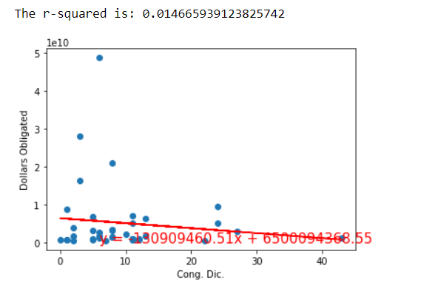

Slide 10
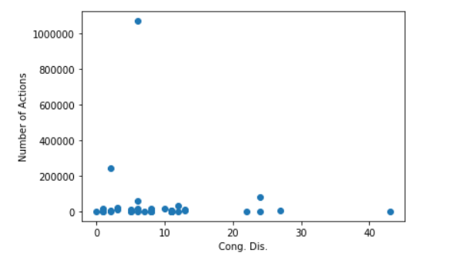
Number of actions vs. Congressional Districts

Slide 11
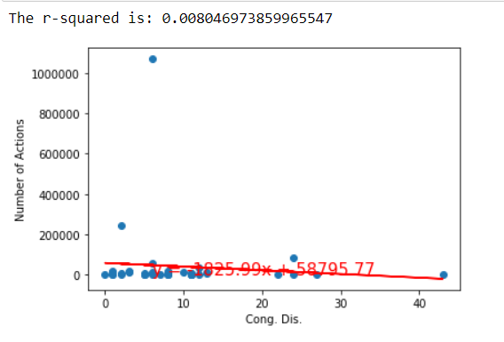

Slide 12
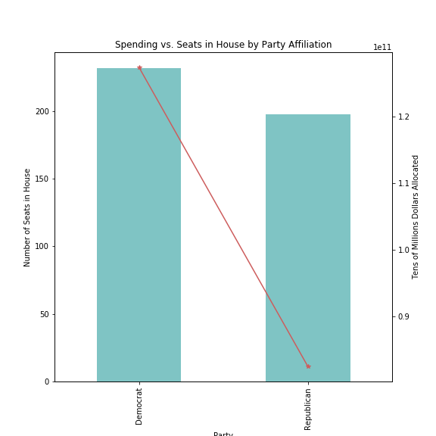

Slide 13
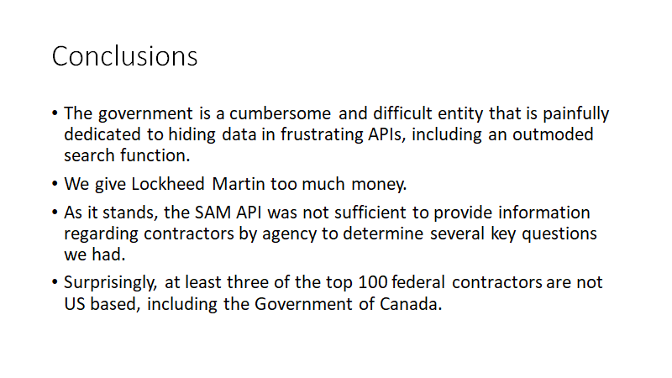

Slide 14
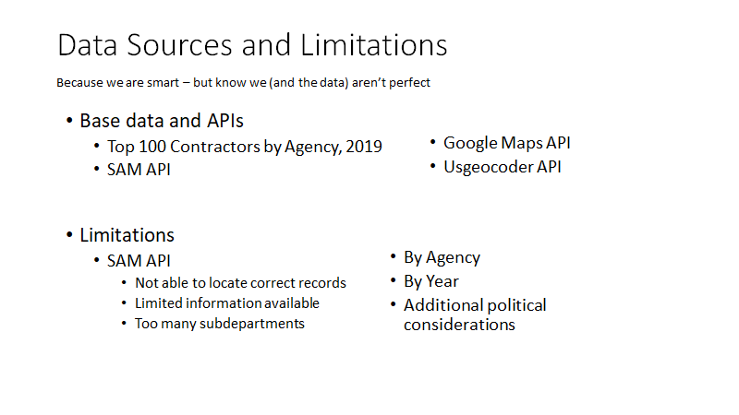

Slide 15
